Slide 1
Indiana Soccer Referees Association Application Development
Team 7- KJAM Developers

Slide 2
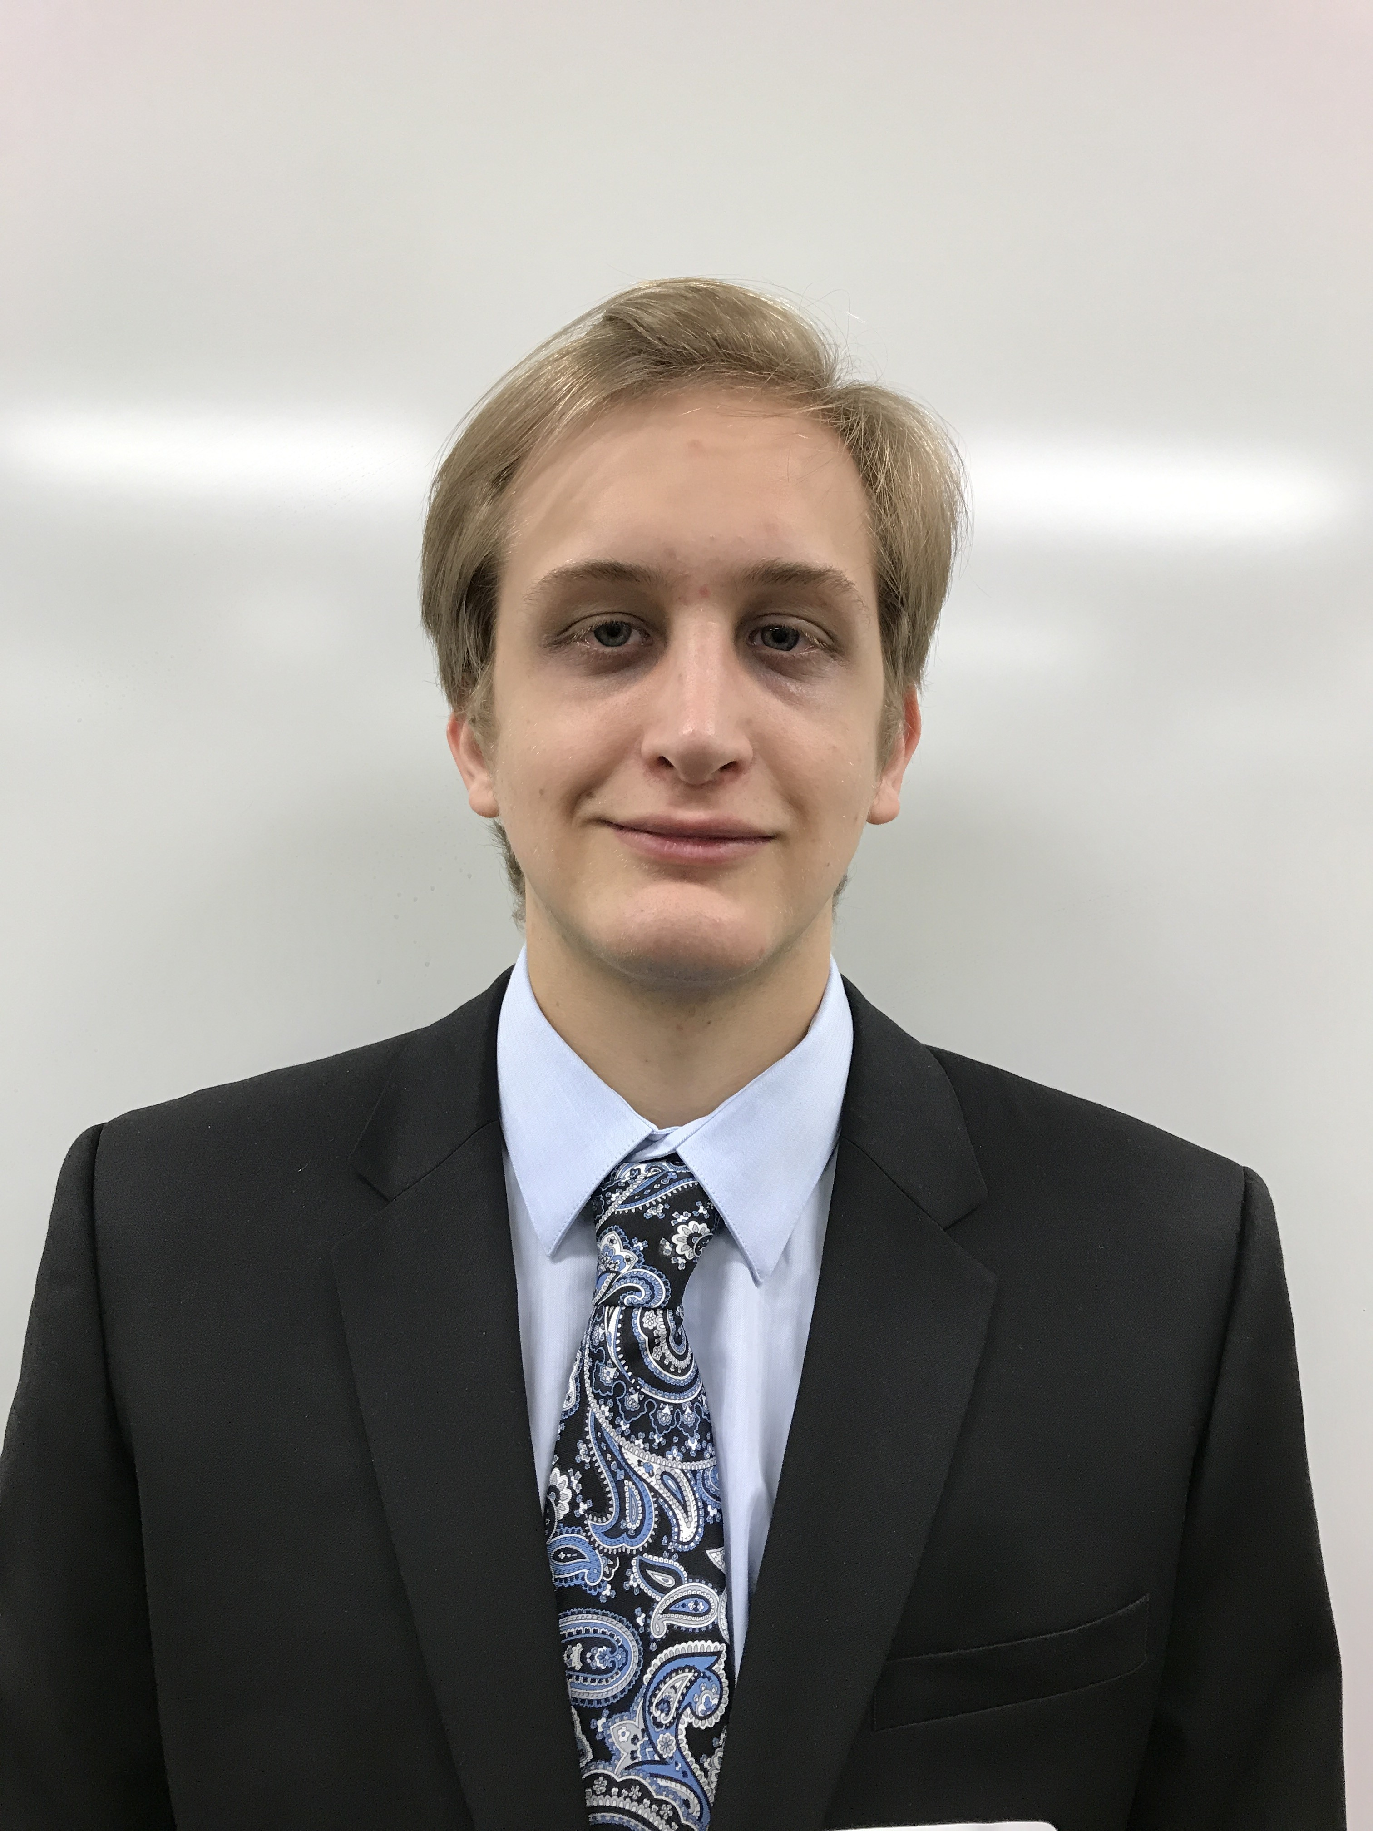



Meet the Team
Mark Villeneuve
mvillene@iu.edu
Avni Sharma
avnishar@iu.edu
Katie-Jane Price
pricekj@iu.edu
Jason Ryu
hyryu@iu.edu

Slide 3
Agenda
Introduction
Business Case
Scope/Timeline/Financials
Approach
Demo
Technology Stack Justification
Team Structure
Design
Insights
Risks

Slide 4
Project Summary
Indiana Soccer Referees Association is responsible for assigning referees to U.S.S.F.-sanctioned club matches in the greater-Indianapolis area
Tracking the assignments and status of each referee manually has become a full-time job. The ISRA has a nonexistent IT team and is unable to develop or host anything in-house.
How can KJAM create a cloud deployable application to manage and track referee assignments?

Slide 5




Business Outcomes We Want to Achieve
Ease of use
Aesthetically pleasing UI design
Clean code that can be open-sourced
Efficient data management of referee info and game assignments

Slide 6
Scope
Data Entry
Reports
Assignment
Game
Referee
Status
Game
Field
Time
Referee
Age
Name
Referee grade
Referee Skill
Position
Date
Type
All games assigned to a referee in a given date range
All future games with at least one position of status “Unassigned”
Referees who have status as assigned
Referees filtered according to Game
Out of Scope
Role based access for “assigner” and regular user

Slide 7
Timeline
 | 25-Sep | 30-Sep | 5-Oct | 10-Oct | 15-Oct | 20-Oct | 25-Oct | 30-Oct | 7-Nov
Draft Data Model
Sketches of app look & flow
Final data model
Load SQL file
Create general HTML template
Create and populate AWS
Begine VueJS and PHP creation
Wireframe pages in HTML
Implement APIs and integrate VueJS
All APIs and VueJS functional

Slide 8
Financials
KJAM Developer Fees
Assumptions
 | Developer1 | Developer2 | Developer3 | Developer4
Avg. Hourly Rate | $ 50.00 | $ 50.00 | $ 50.00 | $ 50.00
Hours Worked Per Week | 15 | 15 | 15 | 15
Length of Project (weeks) | 5.85 | 5.85 | 5.85 | 5.85
Total | $ 4,387.50 | $ 4,387.50 | $ 4,387.50 | $ 4,387.50 | $ 17,550.00
All development and infrastructure tools used have been “free tier”
Future database management may require an updated managed service for additional cost

Slide 9

Approach to Solving the Problem
Update/Delete Referee
Break down the case and requirements
Develop high level understanding of data structure and interactions
Design
Code
Manage Referee
<<Extend>>
Add Referee
Assign Referee
<<Extend>>
Update/Delete Assignments
Referee
Assignor
View Reports

Slide 10
Working App Demo
Click Here: ISRA Referee Assignment App

Slide 11
Business Justification for Technology Stack
Why PHP?
Why VueJS
PHP is Everywhere
Used and run everywhere the web does
HTML rendering and programming easier than most other languages
Multifunctional
Server-side scripting
Command-line scripting
Writing desktop applications
Approachable
Compatible with knowledge in HTML, CSS, and JavaScript
Versatile
Scalable
Performant
20KB min+gzip Runtime
Minimal optimization efforts

Slide 12
Team Structure & Dynamics
KJAM
Data Models/SQL
Design
API Creation/Development
Troubleshooting/Collaboration
Jason
Katie-Jane
Avni
Mark
Met weekly to discuss/plan upcoming milestones
Integrated code from previous assignments
Discussed logical process as a team to have a cohesive understanding of the assignment
** Collaboration assisted through a shared GitHub repo and communication through Teams and group message channels

Slide 13
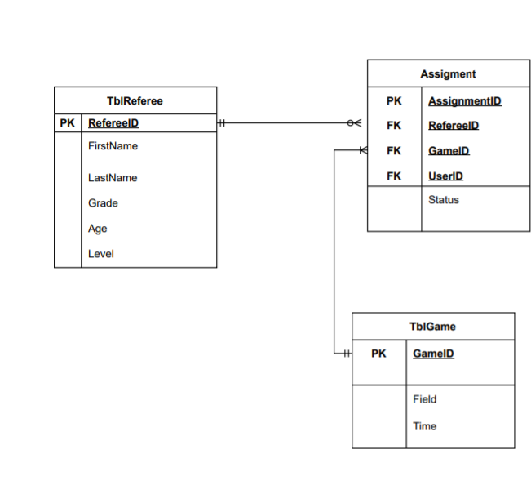

Design Process
Model View Controller
Model
Updates
Manipulates
View
Controller
Sees
Uses
User

Slide 14
What did we Learn?
Name | Thoughts
Mark Villeneuve | Technical- I developed a greater understanding of development and how you need to draw from numerous different approaches to create a usable and seamless experience for the user How to approach debugging and solving a problem from a coding approach which was something that I had never experienced in any other course or experience
Avni Sharma | Learned API dev using JS and PHP Deployment on AWS and Azure Worked more om frontend which I didn't work on much in my past experience Reading docs and more docs
Jason Ryu | Learned how to use PHP, JavaScript to build the server side of web applications and learn how to deploy to online platform utilizing Docker, Azure & AWS Database Developed problem solving skills and learned how to guide through each problem utilizing our knowledges that we acquired form the course
Katie-Jane Price | Developed an understanding of debugging and problem solving when creating functional code Gained experience with virtual database systems and containers such as AWS, Docker, and GitHub to develop a full-scale application shared amongst many contributors

Slide 15

Risks
Risk | Severity | Mitigation
Bugs/errors in code preventing functional APIs |  | Implement debugging techniques throughout code and collaborate with team to solve problems
Misalignment in team vision/understanding of case |  | Spend significant time at the beginning of the case establishing understanding and vision of the project. Communicate constantly and ask for clarification
Failure to meet requirements of the users and business case |  | Clearly define user stories and business requirements. Reference frequently and adhere to success criteria
Probability
Impact
Probability
Impact
Probability
Impact

Slide 16
Q&A

Slide 17

Appendix 1- User Stories
User A
User B
Story:
As an ISRA employee I want to be able to see a list of referees and their credentials so I can appropriately assign them to a game
Success Criteria:
Given I am an assigner, I can view a list of referees and then select them by name to assign them to a specific game.
Story:
As a referee I want to know what games I am assigned to
Acceptance Criteria:
Given I am logged in as a referee, when I click a report of assignments, I can see all the games I am assigned to in a given time frame

Slide 18
Appendix 2- Future Updates and Next Steps
Control inputs for assignments
Cannot assign a referee to multiple positions in a game
Cannot assign a referee to multiple games at the same time
Role based security
Login ID and password
Referee/guest has access to reports
“Assignor” may create/edit/update referees, games, and assignments

Slide 19
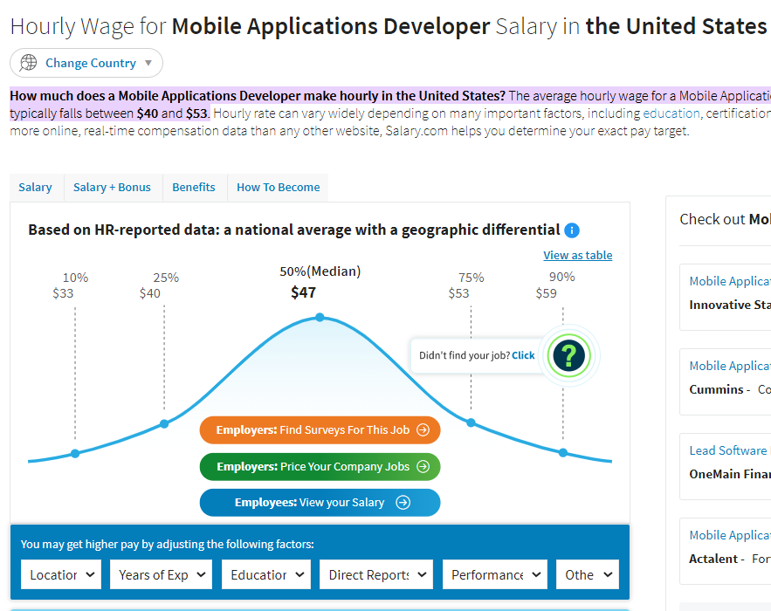
Appendix 3- Financial Estimates
https://www.salary.com/research/salary/benchmark/mobile-applications-developer-ii-hourly-wages#:~:text=How%20much%20does%20a%20Mobile,falls%20between%20%2440%20and%20%2453.

